Slide 1
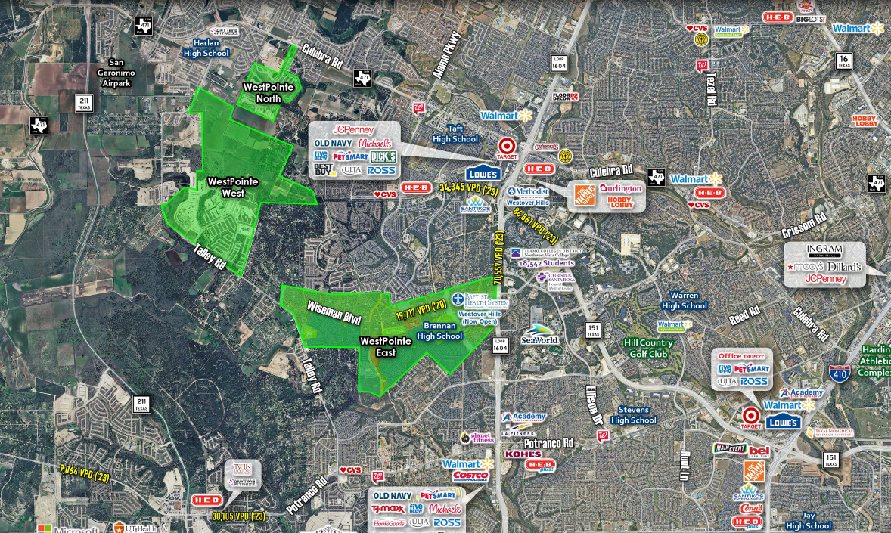




THE VILLAGE AT WEST POINTE
LOOP 1604 | WISEMAN BLVD | TALLEY RD
FAR WEST SAN ANTONIO, BEXAR COUNTY
SITES AVAILABLE
SOLD
SOLD
SITES AVAILABLE
27,500 VPD
SITES AVAILABLE
sullivansa.com
For additional information,
contact:
JAMIE SULLIVAN
210 341 9292 x304
jsullivan@sullivansa.com
ZACH DAVIS
210 341 9292 x309
zdavis@sullivansa.com
200 CONCORD PLAZA DR. STE 440 | SAN ANTONIO. TX 78216

Slide 2
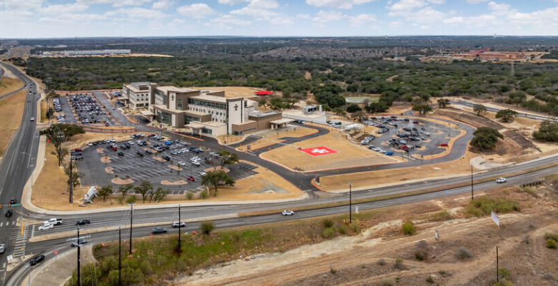

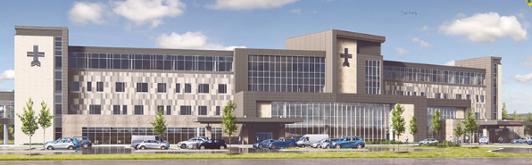
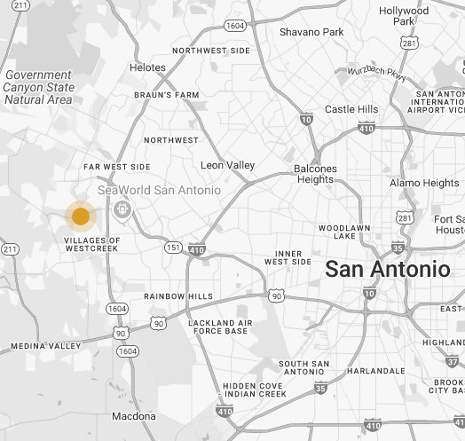

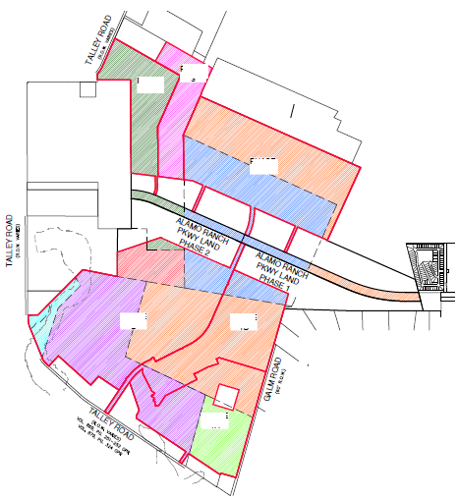

THE VILLAGE AT WEST POINTE
LOOP 1604 | WISEMAN BLVD | TALLEY RD
FAR WEST SAN ANTONIO, BEXAR COUNTY
SITES AVAILABLE
AREA DEVELOPMENT
WEST POINTE EAST
POSITIONED IN ONE OF SAN ANTONIO’S FASTEST GROWING CORRIDORS
WEST POINTE EAST
Loop 1604 @ Wiseman Blvd & Talley Rd.
WEST POINTE WEST
Talley Rd. & Galm Rd. & Alamo Ranch Parkway
UTILITIES
AVAILABLE
Prospective buyers should retain an independent engineer to verify the location, accessibility and capacity of all utilities for buyer’s intended use.
ZONING
OCL
SALE PRICE
CONTACT BROKER FOR PRICING & SITE AVAILABILITY
WISEMAN BLVD
AREA DEVELOPMENT
WEST POINTE WEST
WESTOVER HILLS @ ALAMO RANCH
1,100± ACS by DR Horton
WESTOVER HILLS BAPTIST
72 ACRE MEDICAL CAMPUS
ALAMO
RANCH
$230M SF acute-care hospital + future medical / retail expansion.
SITES AVAILABLE
Sullivan Commercial Realty does not guarantee the completeness or accuracy of the information contained herein and expressly disclaims any duty, warranty or representation, express or implied, related to this information or the property information.
sullivansa.com
For additional information,
contact:
JAMIE SULLIVAN
210 341 9292 x304
jsullivan@sullivansa.com
ZACH DAVIS
210 341 9292 x309
zdavis@sullivansa.com
200 CONCORD PLAZA DR. STE 440 | SAN ANTONIO. TX 78216

Slide 3

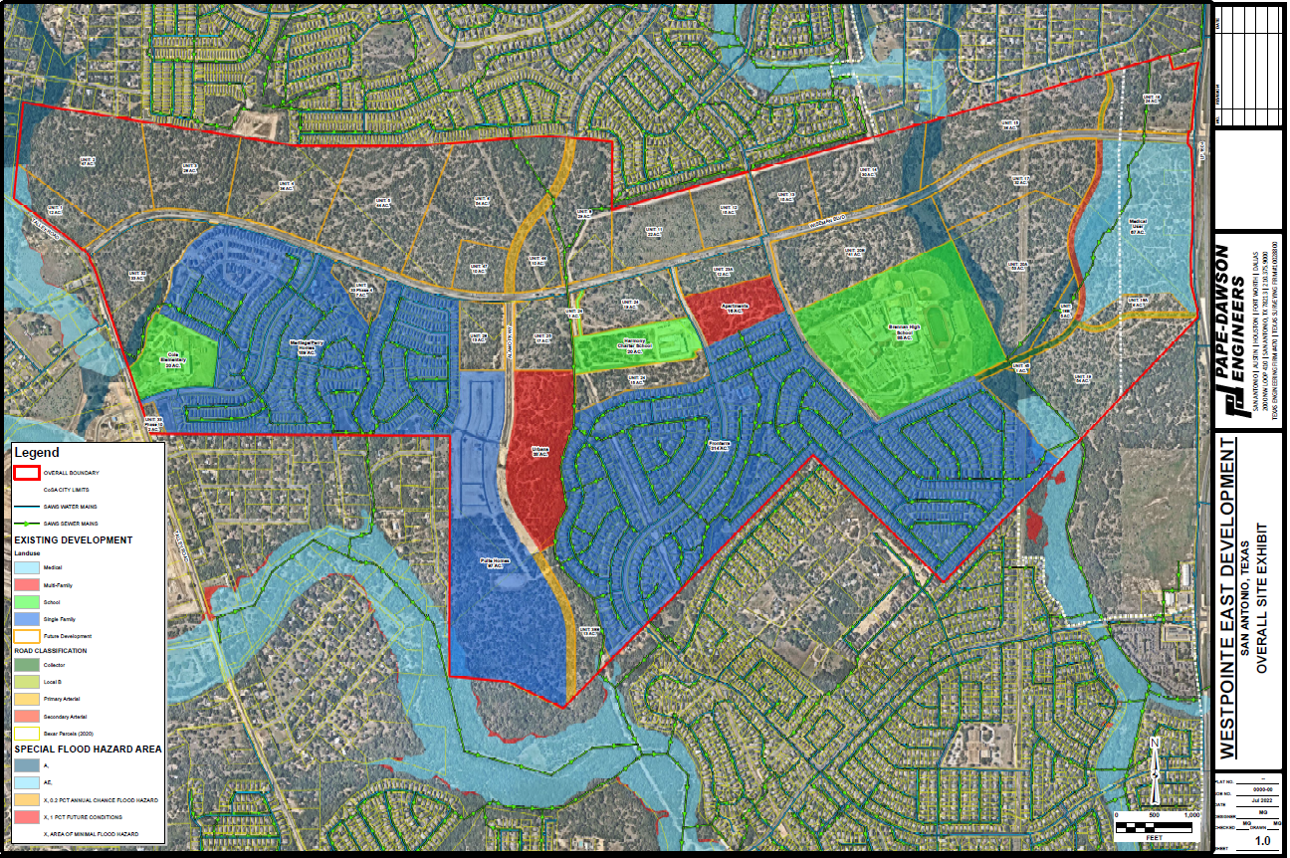



WEST POINTE EAST
LOOP 1604 @ WISEMAN BLVD | TALLEY RD
CLICK TO VIEW
WPE OVERALL SITE PLAN EXHIBIT
Alamo Ranch
4,347 LOTS
WESTOVER HILLS BAPTIST MEDICAL CAMPUS
ALAMO PKWY
TALLEY RD
WISEMAN BLVD
27,500 VPD
Westpointe Oaks
Apartments
350 units
COLE
ELEMENTARY
20 ACS
Trails at Westpointe
785 lots
BRENNAN
HIGH SCHOOL
W LOOP 1604 N
Fronterra
1,070 lots
PULTE
HOMES
106 ACS
sullivansa.com
For additional information,
contact:
JAMIE SULLIVAN
210 341 9292 x304
jsullivan@sullivansa.com
ZACH DAVIS
210 341 9292 x309
zdavis@sullivansa.com
200 CONCORD PLAZA DR. STE 440 | SAN ANTONIO. TX 78216

Slide 4
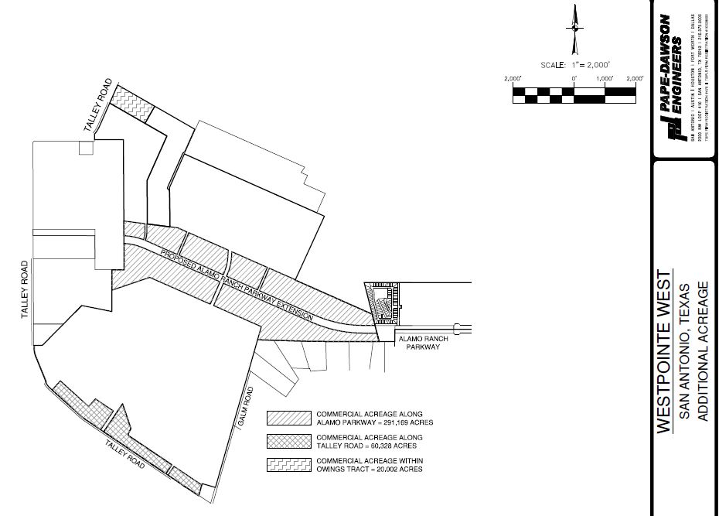


WEST POINTE WEST
TALLEY RD | GALM RD | ALAMO RANCH PKWY
CLICK TO VIEW
WPW COMMERCIAL ACREAGE EXHIBIT
TALLEY RD
TALLEY RD
ALAMO RANCH PKWY
GALM RD
TALLEY RD
sullivansa.com
For additional information,
contact:
JAMIE SULLIVAN
210 341 9292 x304
jsullivan@sullivansa.com
ZACH DAVIS
210 341 9292 x309
zdavis@sullivansa.com
200 CONCORD PLAZA DR. STE 440 | SAN ANTONIO. TX 78216

